Slide 1

Shared Pain vs Split Pain
System Thinking Smells
@LlewellynFalco

Slide 2

Resources
github.com/isidore/Talks/blob/master/Shared_vs_Split_pain.md
Notes:
https://github.com/isidore/Talks/blob/master/Shared_vs_Split_pain.md

Slide 3
Systems Thinking

Slide 4
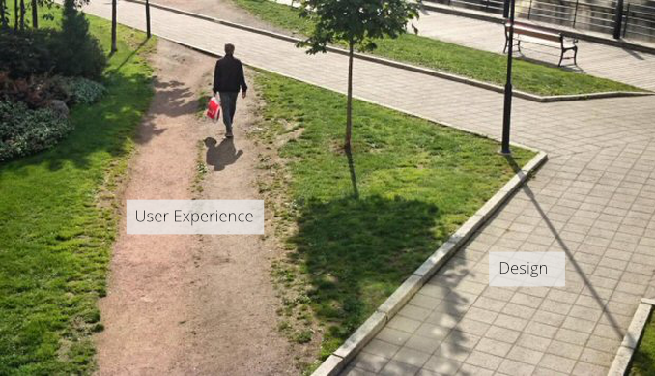

Slide 5

The Cobra Effect

Slide 6
Do the people who create systems
~~study~~
Systems thinking?

Slide 7
Shared Pain vs Split Pain

Slide 8
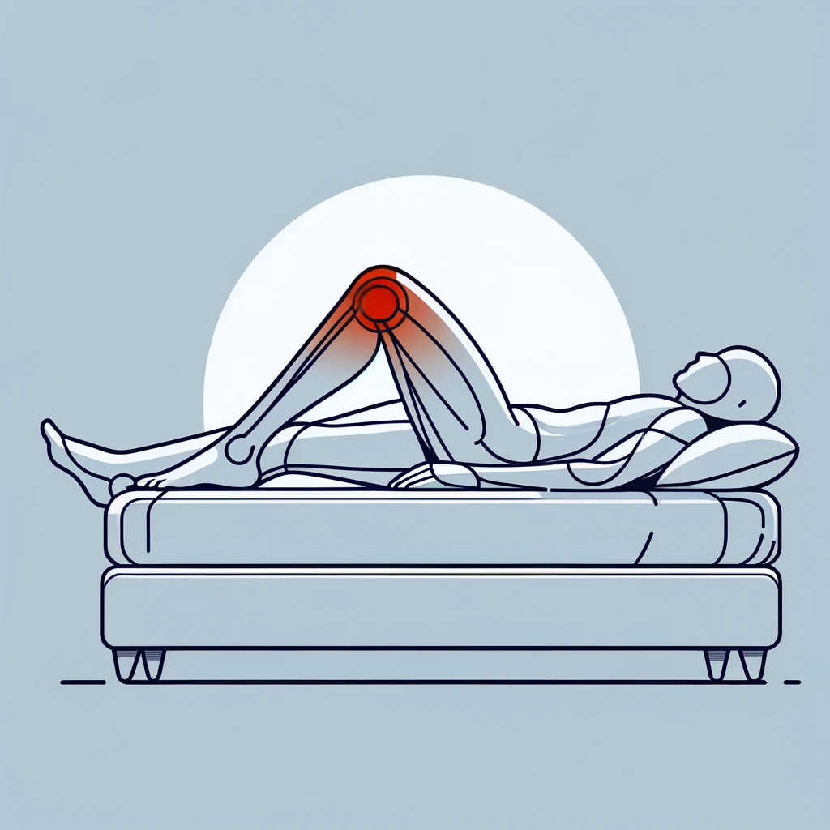

Slide 11


Locked

Slide 12

Story #1 - Devops

Slide 13


Dev
OPs

Slide 14
OPs
Dev
+

Slide 15
Dev
OPs

Slide 16
Dev
DevOPs

Slide 17

Story #2 Cost of build

Slide 18


Slide 19
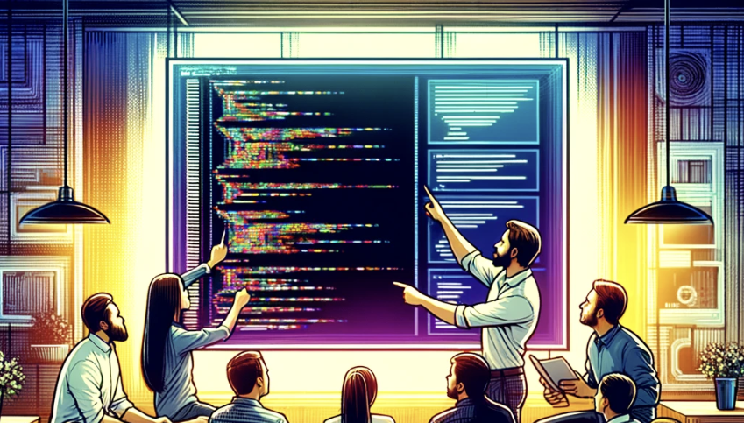

Slide 20

Story #3 – Works on My Machine

Slide 21


Testers
Dev

Slide 22

Story #4 – Testing Videos

Slide 23

Testers
Dev

Slide 24

Testers
Dev

Slide 25

Testers
443 (https)
Dev

Slide 26
Testers
443
Dev

Slide 28
Testers
443
Dev

Slide 29

Story #5 – Working with a library

Slide 30
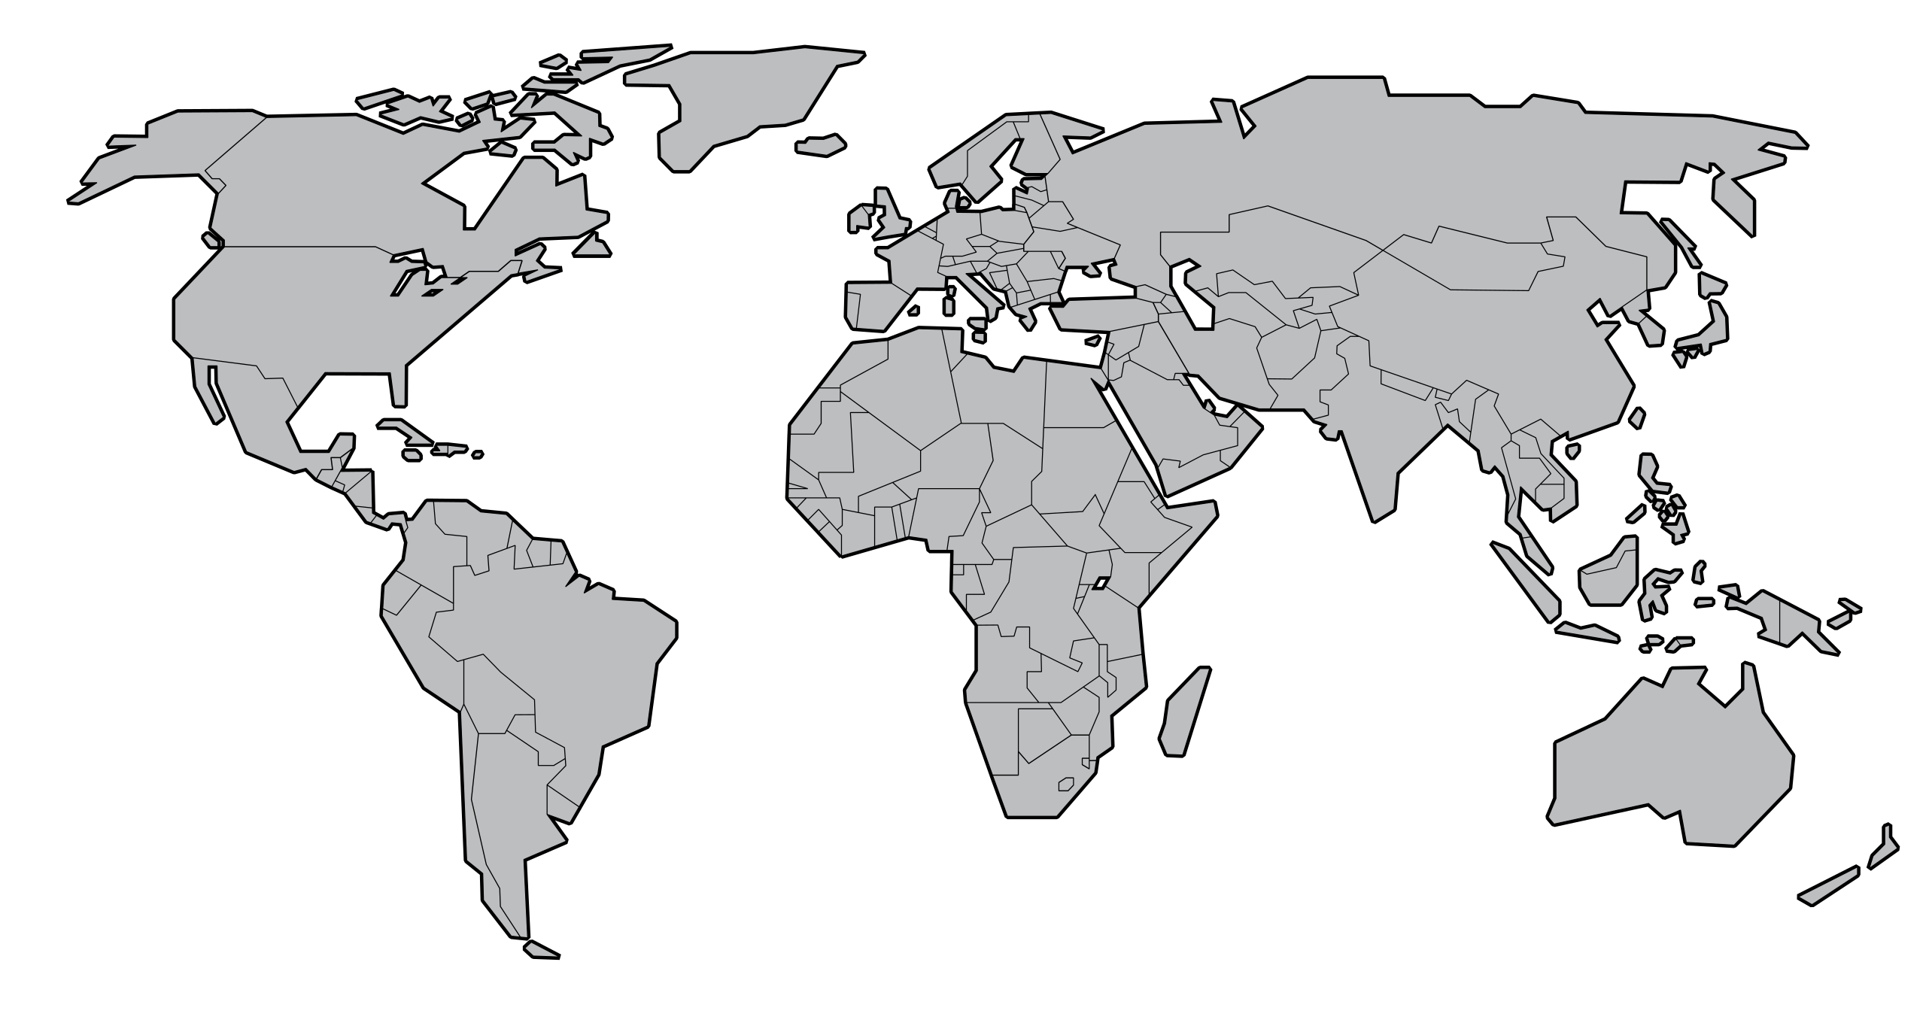

Slide 31


Client
Code
Chris

Slide 32
Client
Code
Chris
Unit Tests

Slide 33

Unit Tests
Chris

Slide 35
Unit Tests
Chris

Slide 36
Unit Tests
Chris

Slide 37
There is currently a security bug bounty. If a security bug is found in production, a reward is paid to the hacker that finds it.
This bounty is paid from the budget of the team responsible for the project.
There has been over $1,000,000 in payouts.

Slide 38

Story #6 – Bug Bounty

Slide 39
There is currently a security bug bounty.
If a security bug is found in production, a reward is paid to the hacker that finds it.
This bounty is paid from the budget of the team responsible for the project.
So far, there has been over $1,000,000 in payouts.

Slide 40
Scenario: A team finds and fixes a security bug before a hacker has reported it.

Slide 41
Q: How long should they wait to release the fix?

Slide 42
Q: How many days should we give the hackers before we release the fix?

Slide 43
A: Usually no more than 2-3 days (Until the Release Management Process gives an OK )

Slide 44
Why?

Slide 45
Dev Team
Code Freeze Team
Penalized if Security Bugs are: * Discovered
* Derivate Bug found
* Bugs take long to fix
Penalized if:
Security Bugs are: * Discovered
* Derivate Bug found
* Bugs take long to fix * Release breaks anything
Best strategy:
Fix Fast and Release
Best strategy:
Be as conservative as possible

Slide 46
Dev Team
Code Freeze Team
Penalized if Security Bugs are: * Discovered
* Derivate Bug found
* Bugs take long to fix
Penalized if:
Security Bugs are: * Discovered
* Derivate Bug found
* Bugs take long to fix * Release breaks anything
Best strategy:
Fix Fast and Release
Best strategy:
Be as conservative as possible

Slide 47
Dev Team
Penalized if Security Bugs are: * Discovered
* Derivate Bug found
* Bugs take long to fix
Code Freeze Team
Penalized if:
Security Bugs are: * Discovered
* Derivate Bug found
* Bugs take long to fix * Release breaks anything
Best strategy:
Fix Fast and Release
Best strategy:
Be as conservative as possible

Slide 48
?
?
Company
?
Dev Team
?
?
Penalized if Security Bugs are: * Discovered
* Derivate Bug found
* Bugs take long to fix
Code Freeze Team
Penalized if:
Security Bugs are: * Discovered
* Derivate Bug found
* Bugs take long to fix * Release breaks anything
Best strategy:
Fix Fast and Release
Best strategy:
Be as conservative as possible

Slide 49


Messaging Engine Team
Team penalized if Security Bugs are: * Discovered
* More found
* Bugs take long to fix
Error connecting to database with user: tmobile and pw: helloWorld
Code Freeze Policy
48 to fix
Found, Fixed & tested with 1 hour
Management Penalized if: * Release breaks anything
Also found another endpoint with same vulnerability
Release to Production?
Best strategy: Fix and Release quickly
“Let’s wait…”
Best strategy: Do nothing

Slide 50
Do the people who create systems
~~study~~
Systems thinking?

Slide 54

Story #7 – Your Story
Notes:
https://miro.com/app/board/uXjVN18DCHU=/

Slide 55

Resources ⟹
Thank You!
@Llewellyn Falco
(Please connect on LinkedIn)
github.com/isidore/Talks/blob/master/Shared_vs_Split_pain.md
Notes:
https://github.com/isidore/Talks/blob/master/Shared_vs_Split_pain.md

